Slide 1


ParsEVTX: Simplifying EVTX Analysis
Host:
ERIC HENDRYANI

Slide 2



01
EVTX Files
What are they?

Slide 3



EVTX Files
EVTX files are Windows Event Log files that store different types of event records in a structured binary format. Unlike normal text files, EVTX files need a special application (such as Event Viewer or EvtxECmd) to parse and read their contents.

Slide 4
Windows organizes EVTX files into different categories based on the type of events they record
System
Security
Application
Operational
Captures events related to Windows components like drivers, system services, and hardware issues.
Tracks authentication events, login attempts, file access, and other security-related activities, though it only logs events if auditing policies are enabled.
Records events from installed programs and software applications.
Provide detailed diagnostic information for specific Windows features and services.

Slide 5
Why Should We Use EvtxECmd?
Event Viewer becomes extremely slow when working with large log files and can only display one log at a time. EvtxECmd converts all EVTX files into a single CSV file in minutes, which can then be analyzed in Timeline Explorer with powerful filtering and search capabilities across all logs simultaneously. This transforms investigations from hours or days of manual work into just minutes of efficient analysis.

Slide 6
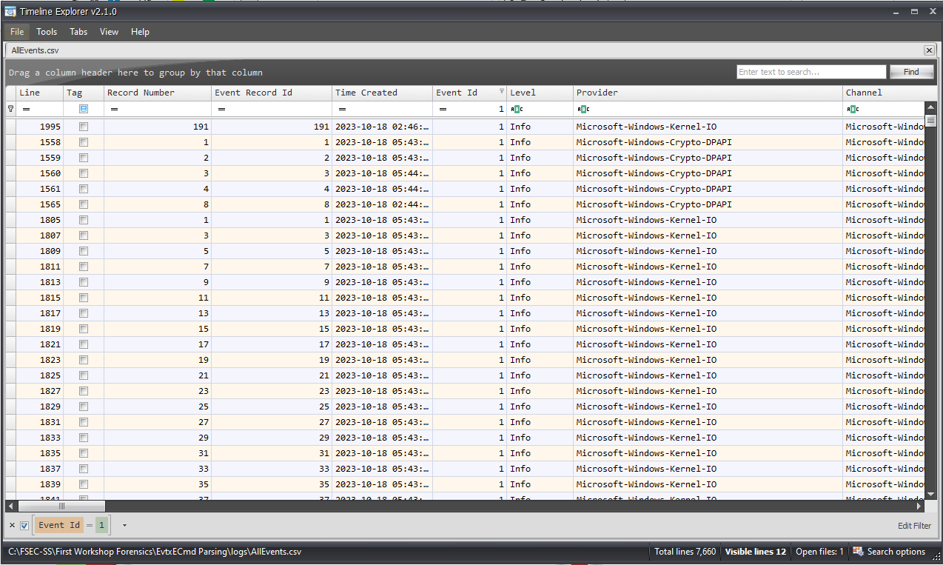
Timeline Explorer
Timeline Explorer is a digital forensics tool that analyzes event logs by organizing them into chronological timelines. This helps cybersecurity professionals identify suspicious activities and security incidents. Timeline Explorer works perfectly with EvtxECmd by importing the CSV files that EvtxECmd creates, making event log analysis fast and efficient

Slide 7

The DFIR Goat! (In my opinion)
In the field of Digital Forensics and Incident Response (DFIR), Eric Zimmerman is widely considered one of the most influential and significant contributors, he is also a former Federal Bureau of Investigation (FBI) Special Agent
At SANS, he teaches the FOR508: Advanced Digital Forensics, Incident Response and Threat Hunting course, and is a two-time winner of the SANS DFIR NetWars Tournament (2014, 2015).
Created many world-class, open-source forensic tools. (Shellbags Explorer, Timeline Explorer, EvtxECmd, Registry Explorer, etc)
Eric Zimmerman |
SANS Institute

Slide 8
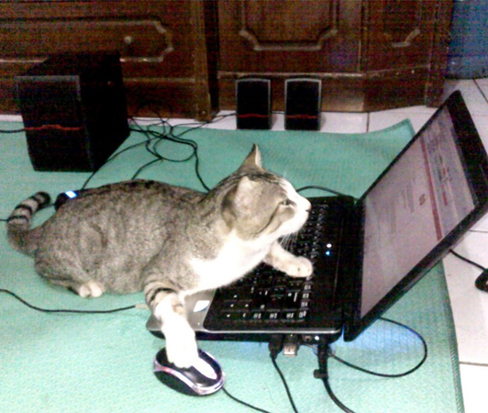
02
Tutorial
Let’s try it out!

Slide 9
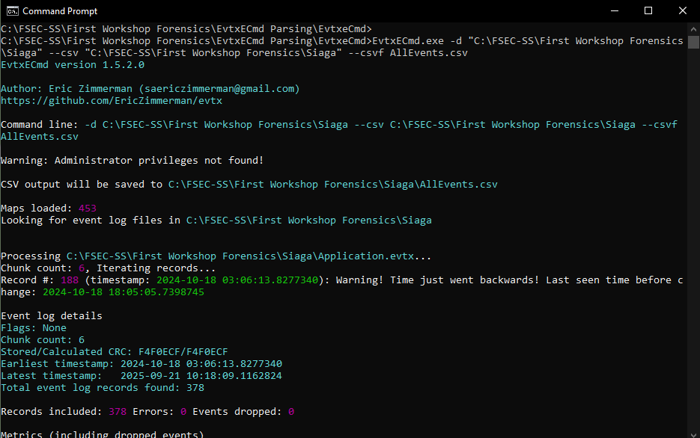

Converting EVTX’s to CSV’s
Converting Single EVTX File Into CSV
Converting ALL EVTX Files In A Directory Into A Single CSV
Filtering To Include Only Specific Event IDs In CSV Output
EvtxECmd.exe -f "location of .evtx file" --csv "location where you want to save the file" --csvf Filename.csv
EvtxECmd.exe -d "location of the directory" --csv "location where you want to save the file" --csvf Filename.csv
EvtxECmd.exe -d "location of the directory" --csv "location where you want to save the file" --csvf Filename.csv –inc “eventid”

Slide 10
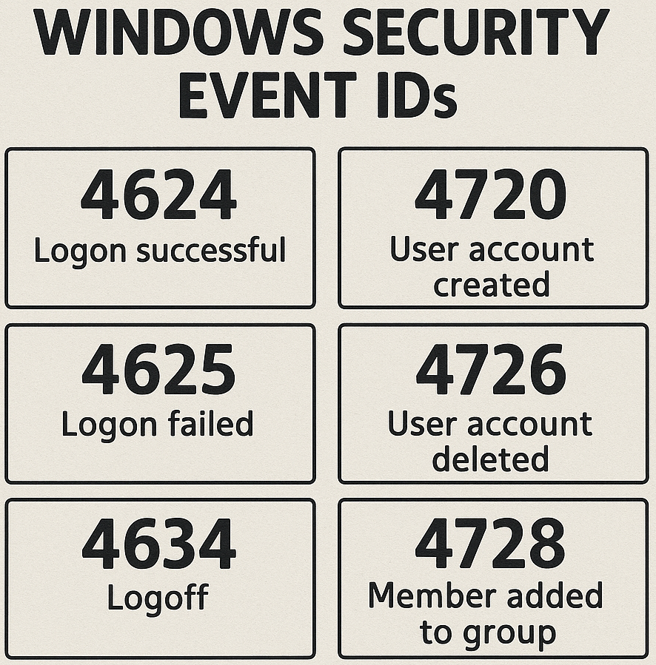

What are EventIDs?
Event IDs are unique numerical identifiers assigned to specific types of events recorded in Windows Event Logs. Each Event ID corresponds to a particular action or occurrence in the system.

Slide 11
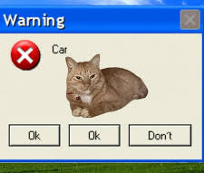
03
Utilizing A.I
How to utilize the use of A.I efficiently to solve challenges faster

Slide 12
EventID’s Classification
Starting the Analysis
When we parse EVTX files into CSV format using EvtxECmd, it provides a count of each Event ID occurrence for the specified EVTX file or all files if indicated. We can use this by copying the Event ID counts into GPT and asking which Event IDs we should prioritize investigating first based on the challenge question, or to better understand what type of event each Event ID represents.
Note: It may be hard to copy the counts of EventIDs, so we can redirect the output to a text file by adding: “ > “filename”.txt at the end.

Slide 13

The Prompt
“Based on the provided text file, classify each Event ID and briefly explain what type of event each one corresponds to. Additionally, identify which Event ID is the most significant or worth investigating further in relation to the given challenge description: (insert challenge description here).
Note: Make sure to attach the text file
which holds the output of the conversion
from EVTX to CSV (from EvtxECmd)

Slide 14



Thank You! (time for some challenges ☺)

